Slide 1
LT Operations Monitoring
A new architecture for telescope systems telemetry

Slide 2
Introduction
Introduction to systems monitoring
Telemetry architecture
Operations UI architecture
Demonstration

Slide 3
PART 1 - Systems Monitoring

Slide 4
Systems Monitoring
What is it and why do we need it ?
Finding out what the system is doing.
Measuring its performance against metrics.
Detecting problems early.

Slide 5
Solutions
Logging
text generated by embedded code
A human readable account of what the various software components of the system are doing.
Telemetry
data generated by embedded code
structured data which can be used by remote clients to interpret and analyse what the system is doing.

Slide 6
Logging
May be formatted to show things like:
Time
Source component
Level of detail
Keywords to highlight specific categories of message.
Error
StartingOperation
DataReceived
CalculationResult
Data logging – logging values of environmental variables
(sometimes confusingly called telemetry)

Slide 7
Telemetry
Event notifications
starting-scheduler-sweep (time, swpno, conditions)
completed-group (group, duration, status)
Environmental variables
buffer-size
instrument-temperature
rotator-position
wind-speed

Slide 8
Logging versus Telemetry
Telemetry differs from logging in terms of both goals and content.
Logging attempts to provide information for both operational monitoring and software debugging.
In doing so, it is required to serve two masters and often neither of them particularly well.
The software developer is constantly faced with the problem of what to log with the result often being too much and too little is logged, at the same time.
Telemetry is focused solely on providing information that is useful for understanding the operation of the software from an operational perspective.

Slide 9
Operations Monitoring
How healthy is the application ?
What errors is the application encountering that block proper operation ?
How well is the application performing?
What external dependencies does the application have that might impact it's operation ?
Are the business metrics in the appropriate ranges ?

Slide 10
Software versus Operations
Developers are more focused on the flows of the application internally while operations are more focused on ensuring the business goals are being met by the system.
Developers need to understand why the application fails in a particular way while operations needs to understand what components can impact the application and how those components are behaving.
The challenge to date has been that logging frameworks, which are focused on the application developer have been pressed into the secondary duty of providing operational information as well.

Slide 11
For and against
 | Logging | Telemetry
For | Trace events in sequence Human readable May be able to extract info using scripts | Machine readable Interpret sequences Disentangle multi-threaded issues Extract timing information Instantaneous display
Against | Difficult to disentangle multi-threaded logs. Difficult to extract embedded sequences Scripts reliant on constancy of message format. | Needs clients written and modified if message format changes Not immediately human readable

Slide 12
Performance analysis
Measuring system metrics
Low level logging
Simple logging.
Medium level logging
Add categories keys, operation timings
High level logging
Operation statistics
Embedded monitoring
Full monitoring, analysis, statistics.
Telemetry
External client performs analysis and statistics.

Slide 13
Metrics
Monitoring System | Operator effort | System intrusion
Low level logging | V. High | Low
Medium level logging | High | Medium
High level logging | Medium | High
Embedded monitor | Low | V. High
Telemetry | Low | Low

Slide 14
Scenario
System has numerous processes running in parallel and interleaved.
We are only interested in instances of process (A).
While these (A)’s are running, associated sub-processes B,C, D, E etc will also run but not always the same ones and not in same order.
Aims are to measure:
Average run time of an (A) process.
How many sub-processes run by (A).

Slide 15
Scenario solution (1)
Low level logging
Can we identify in log which processes are (A) ?
Starting process A-16
Do we log both start and end of an (A) process ?
End process A-16
Can we identify B, C, D etc in the logs ?
Starting sub-process B-3
Starting sub-process A-16.B2

Slide 16
Just need to check these logs !
Might be able to grep for starting process and then
manually go thro identifying which type
note start and end times
work out duration
count number of other processes starting and ending in that period
then sum up and calculate average etc

Slide 17
Scenario solution (2)
High level (intelligent) logging
Embedded code works out the start and end of each process and totals up the run-time, running average and standard deviation.
Sometimes processes B,C,D etc run outside the context of a process (A) so the code needs to be doctored to push various flags around telling the monitoring code whether to record stuff or not.

Slide 18
Scenario solution (3)
Telemetry
System sends out messages when each process starts and ends along with time and process class.
Receiving client extracts sequence information, calculates average, std dev etc.
Plots graphs of runtime against time,
histogram of range of runtime and number of sub-processes,
data fields showing current runtime and number of sub-processes running,
indicator showing red if runtime is too high, green if in-range.

Slide 19
Is it working ?
The green light is on so all is well.
I see the run-time has settled down over the last hour.
We seem to be running a lot of sub-processes at the moment

Slide 20
PART 2 – Telemetry Architecture

Slide 21
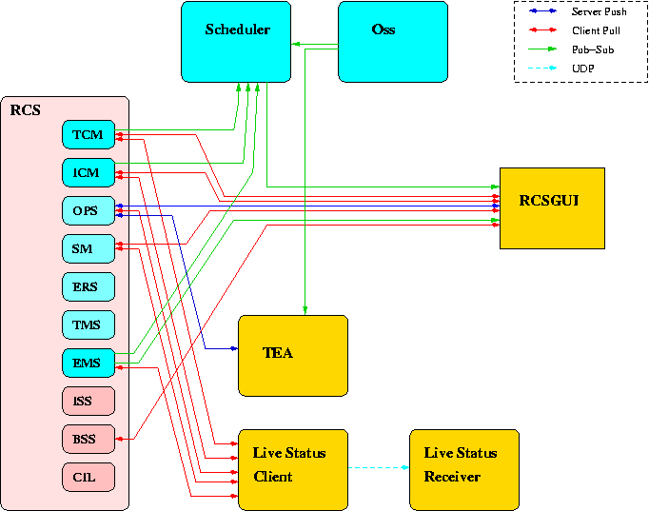
Old Telemetry Network

Slide 22
Design Requirements
Different streams of data should all look essentially the same - consistent architecture.
Extendable to new systems.
Able to obtain historic data in addition to live data.
Event data available as it happens.
Detachment of source from receiver.

Slide 23
Getting the data
Polling
Client sends out requests to server at regular intervals.
Publish-Subscribe
Client subscribes to feed, system sends out data as available.

Slide 24
Polling v Pub-Sub
 | Polling | Publish-Subscribe
For | Conceptually simple | Minimum intrusion to system. Up to date, speed matching. Event handling. Add new data categories easily.
Against | Infrastructure at system. Poor for event handling. Over/under sampling. Client polling -infrastructure and configuration. | Re-registration “polling”.

Slide 25
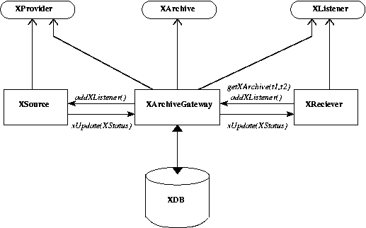
Telemetry Architecture

Slide 26
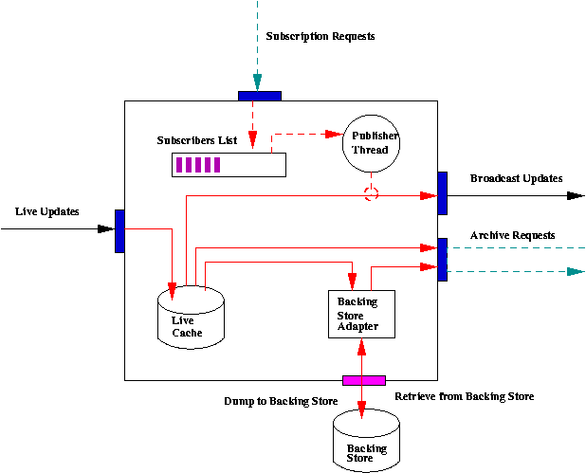
Gateway architecture

Slide 27
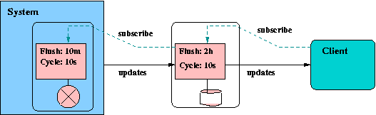
Single System

Slide 28
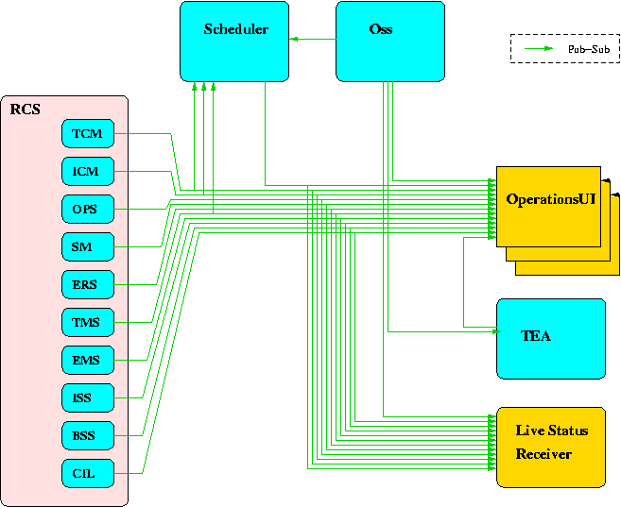
New Telemetry Network

Slide 29
PART 3 – UI Architecture

Slide 30
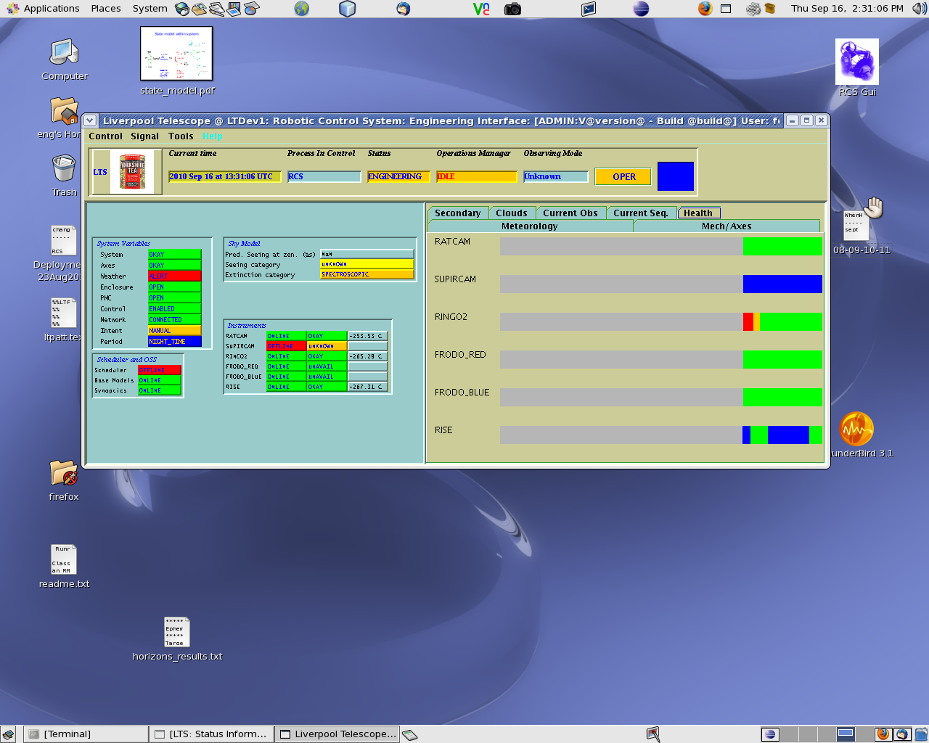
Old RCS-GUI

Slide 31
Design Requirements
Displays from different sources (themes/topics) collected together.
Easy to personalize – individual user configuration of layouts and content.
Able to link components to do searches, tracing, auditing.

Slide 32
Terminology
Perspective
A component which processes all of the data relating to a particular theme/topic.
Typically this originates from a single source/provider.
Contains various visual display sub-components.
Graphs, Histograms, Data fields, State indicators, Timelines, Tables, Trees, Custom components.
Display
A frame or window containing one or more perspectives.
Layout
A collection of displays.

Slide 33
Perspectives
Scheduling
Instruments
Operations
Telescope
Meteorology
Task Management
Reactive State Model
PhaseII
Tracking
Services

Slide 34
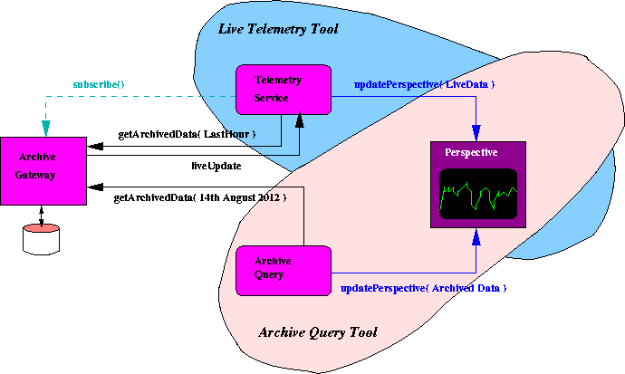
Communications

Slide 35
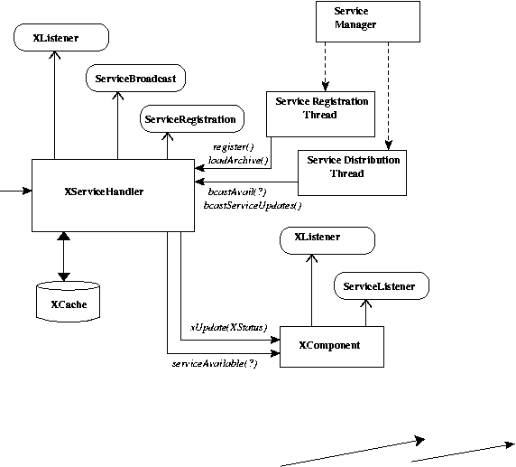
GUI Architecture

Slide 36
Multiple Systems

Slide 37
PART 4 – Operations UI demo

Slide 38
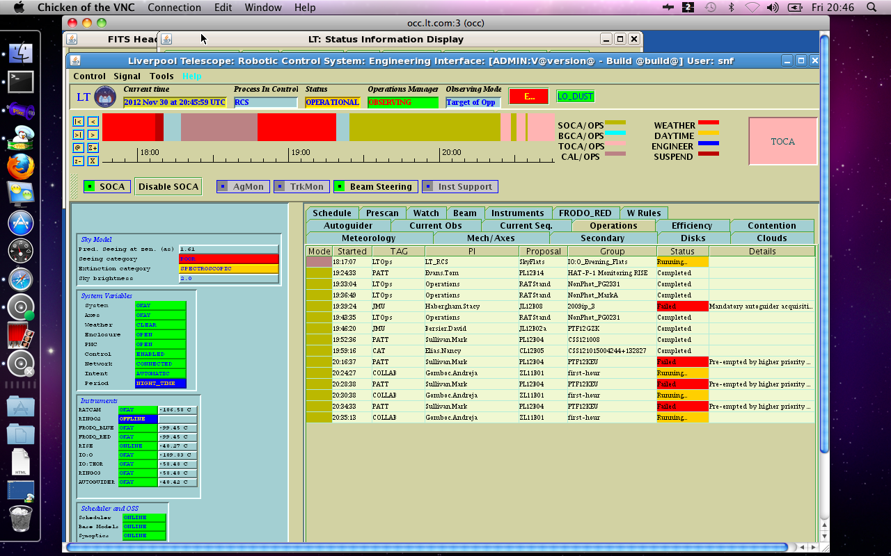
Current RCS-GUI

Slide 39
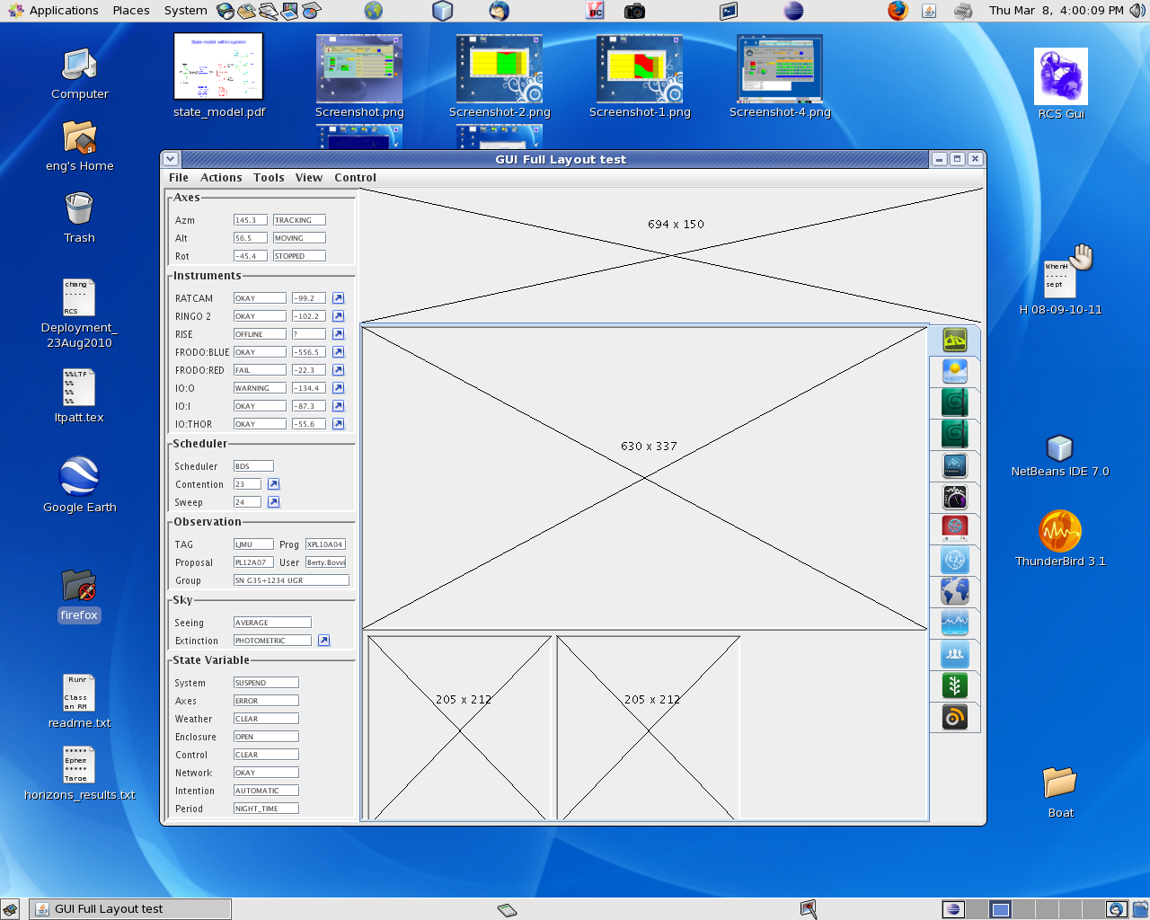
Ops UI: General Layout

Slide 40
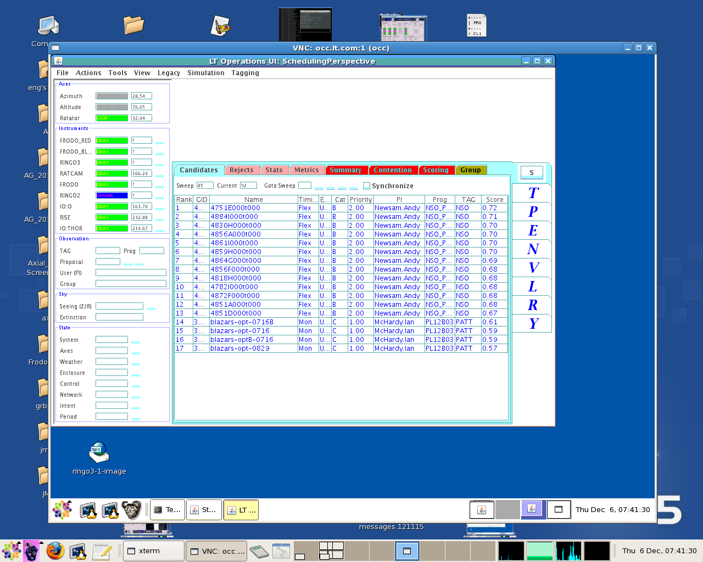
Ops UI: Sched:Candidates

Slide 41
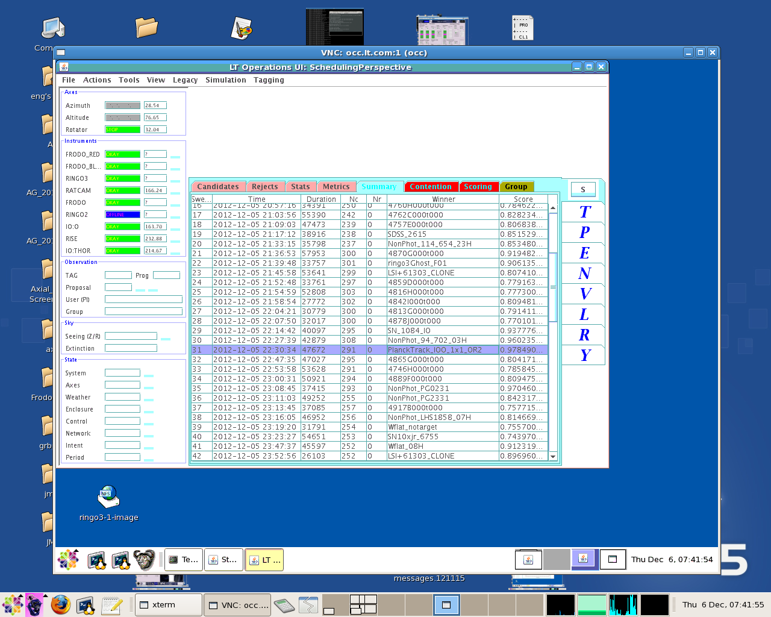
Ops UI: Sched:Summary

Slide 42
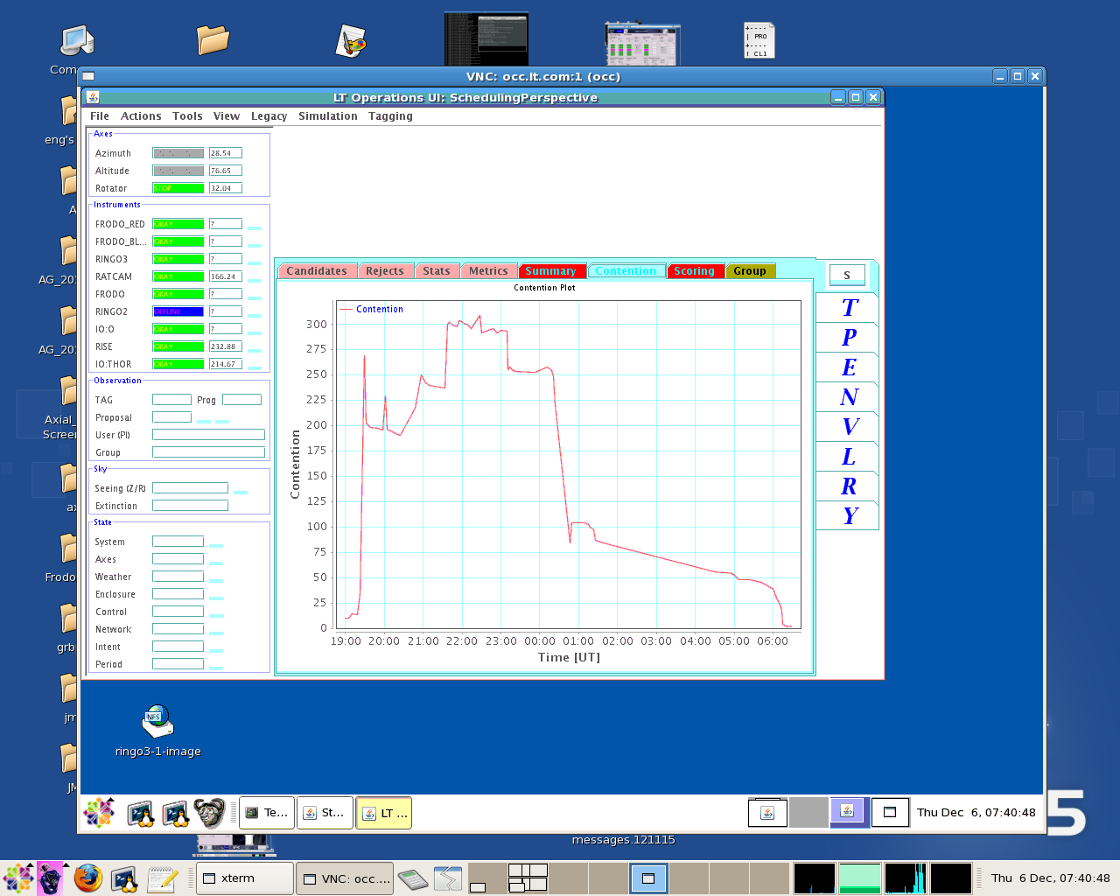
Ops UI: Sched:Contention

Slide 43
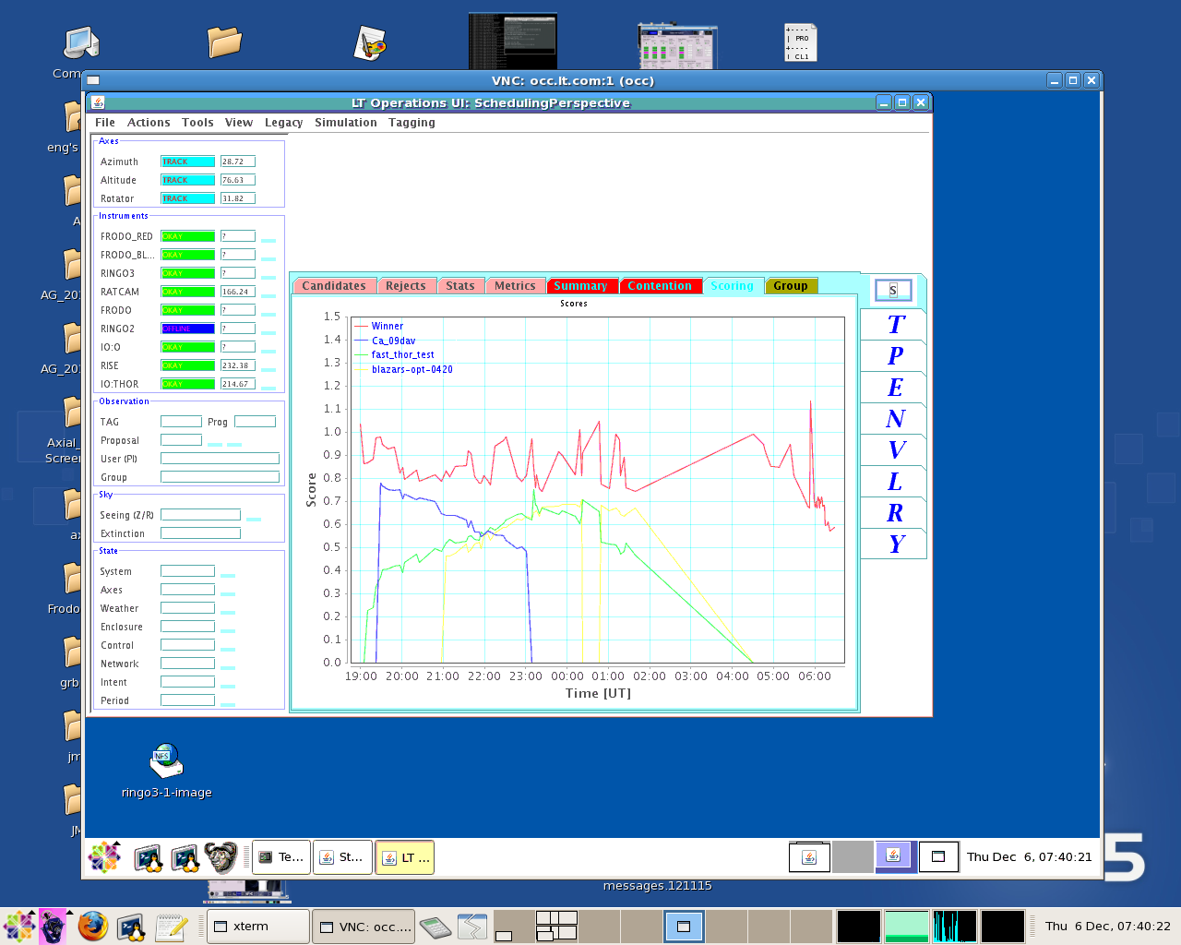
Ops UI: Sched:Scoring

Slide 44
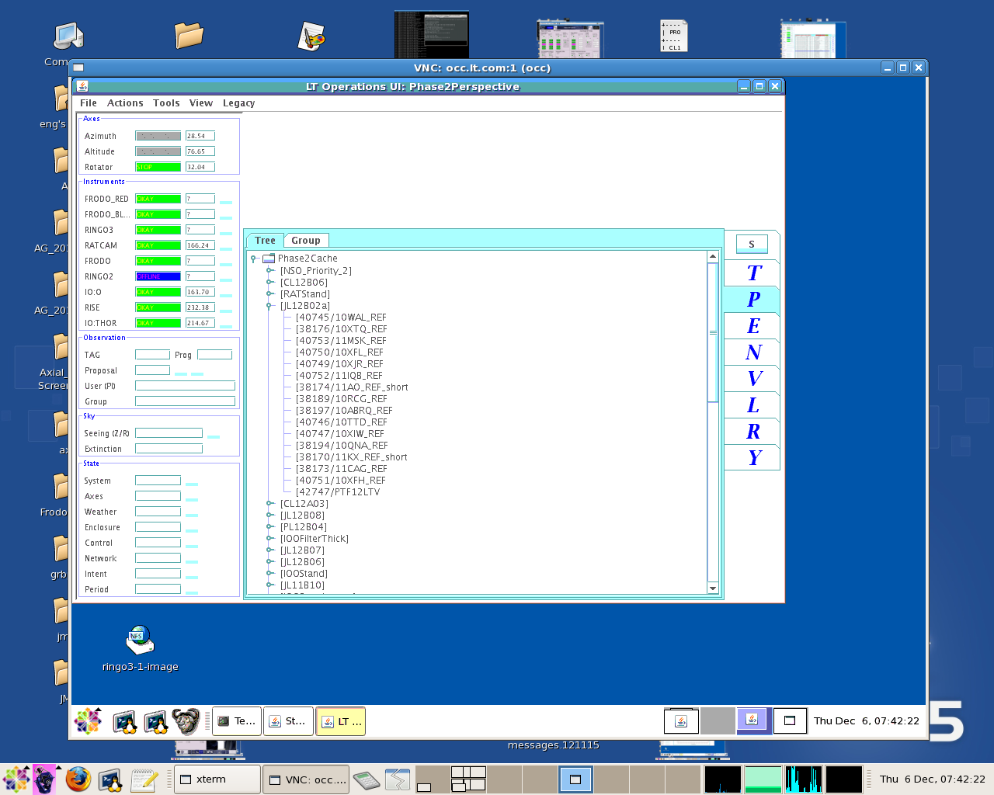
Ops UI: Phase2:Tree

Slide 45
Ops UI: Phase2:Feasibility

Slide 46
Ops UI: Phase2:SkyBSlice

Slide 47
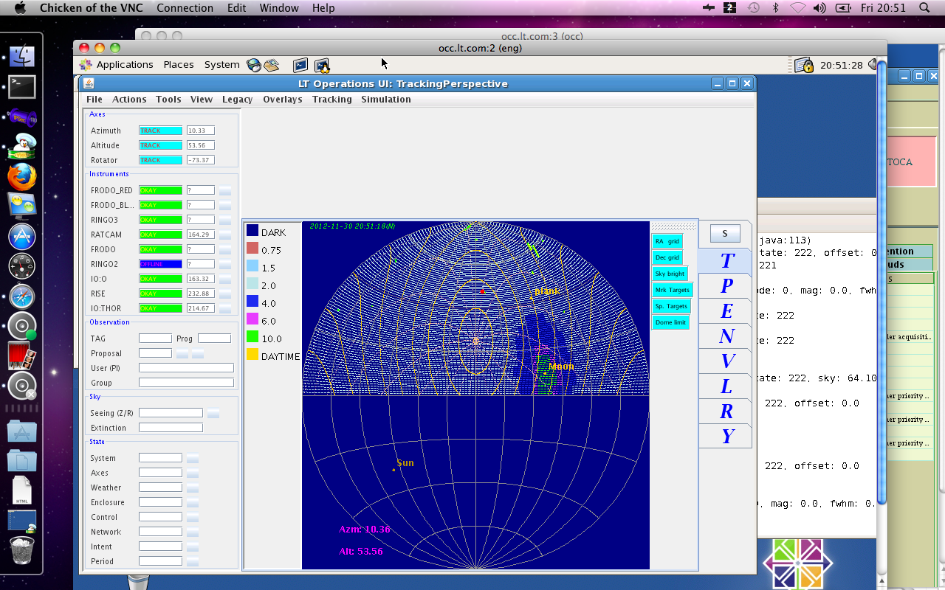
Ops UI: Tracking:Altaz

Slide 48
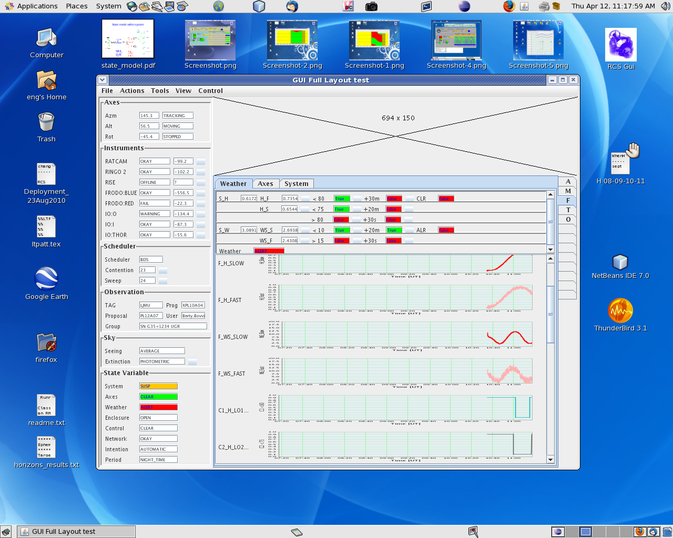
Ops UI: ERS:MeteoGraphs

